Slide 1
Lexical Propagation On Twitter With @dog_rates
Source: This Paper is About Lexical Propagation on Twitter. H* ckin Smart. 12/10. Would Accept!, Proceedings of the 2018 IEEE/ACM International Conference on Advances in Social Networks Analysis and Mining (ASONAM), 2018.
Original Authors: Jennifer Golbeck And Cody Buntain
Presented By: Matthew Stevenson
Course: CS895, Date: 2019-03-27

Slide 2
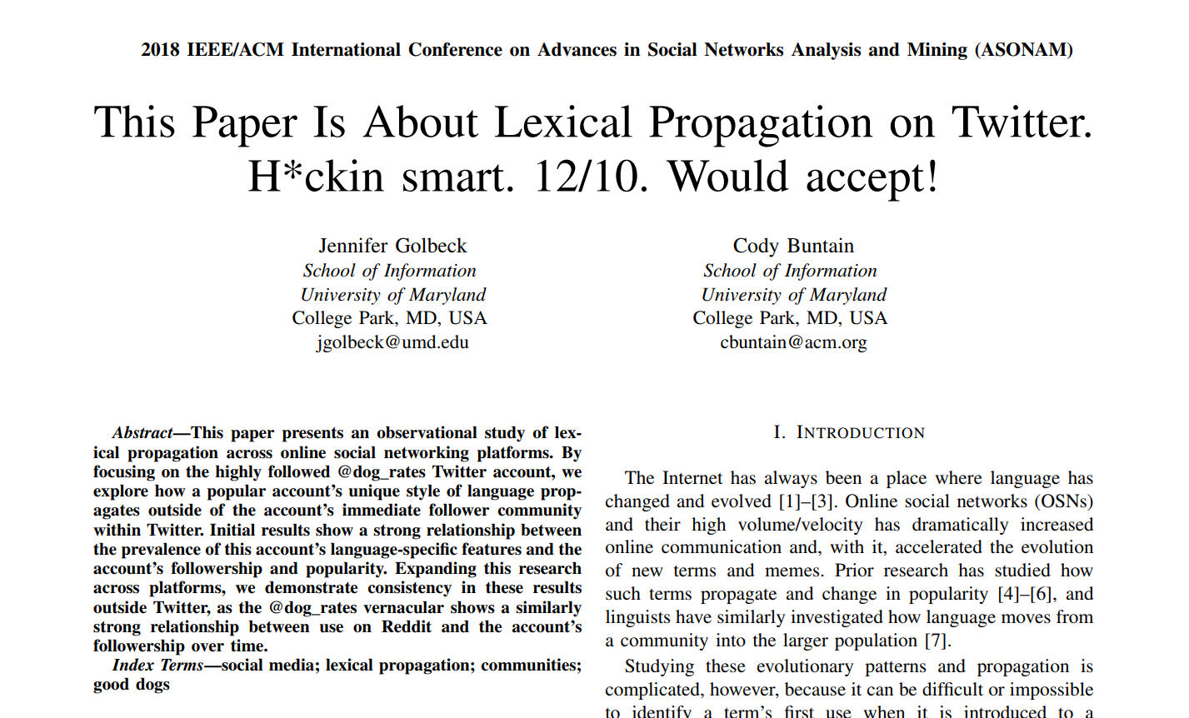
https://scholar.google.com/scholar?oi=bibs&cluster=209679957075183025&btnI=1&hl=en

Slide 3
Twitter Account: We Rate Dogs or @dog_rates
As of late 2017, the twitter account reached over 5 million followers
Account attracts followers looking for humor and to look at cute dogs
Originated the phrase “_/10. Would ___”
Introduced to a different language style using “h*ck” for the word “heck” and also other dog related puns like “pupdate” for “update”
Account created November 2015
https://scholar.google.com/scholar?oi=bibs&cluster=209679957075183025&btnI=1&hl=en

Slide 4
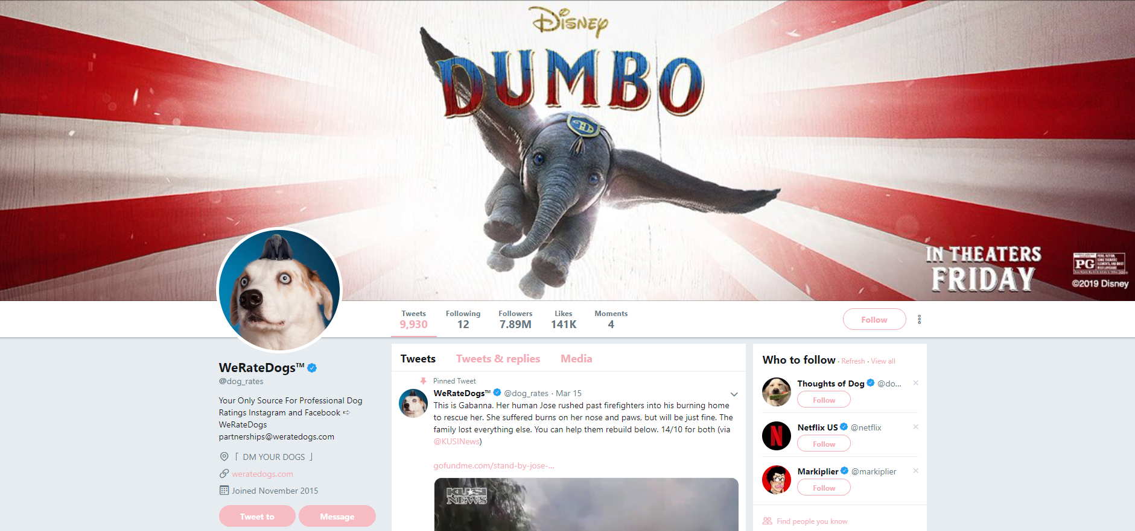
Current Twitter Account, 2019-03-24
https://twitter.com/dog_rates

Slide 5
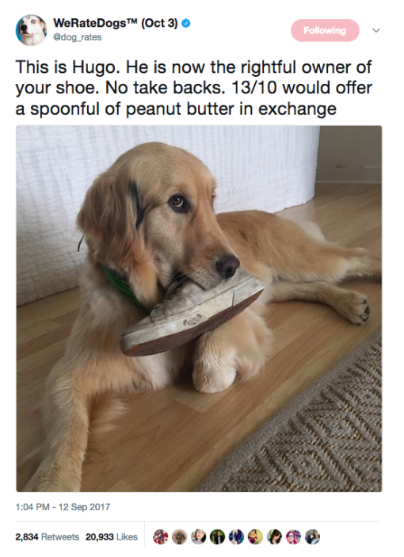
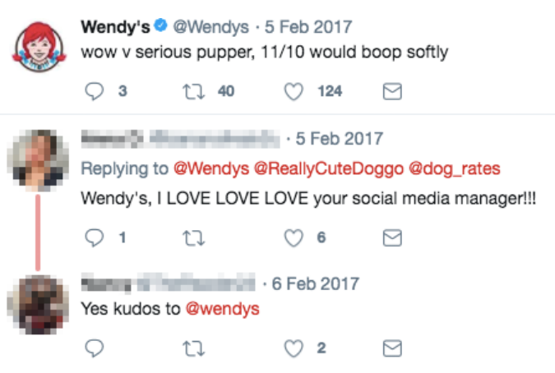
Uses Of Phrases In Social Media
https://scholar.google.com/scholar?oi=bibs&cluster=209679957075183025&btnI=1&hl=en

Slide 6
Uses Of Phrases In The @dog_rates Account
https://twitter.com/dog_rates/status/1110320393477332992

Slide 7
Interaction With @dog_rates and @brant
https://knowyourmeme.com/photos/1225812-theyre-good-dogs-brent

Slide 8
Why A Case Study With We Rate Dogs?
To better understand the propagation of internet slang being introduced and its spread among the community
Expansion of internet slang outside the originating community
And to answer the questions:
“How much influence does a single popular account have on language in multiple social media platforms?”
“Does a linguistic pattern transition from within an account's community to outside that community?”
https://scholar.google.com/scholar?oi=bibs&cluster=209679957075183025&btnI=1&hl=en

Slide 9
What Effects Does Internet Slang Have?
Let Us Take A Look

Slide 10
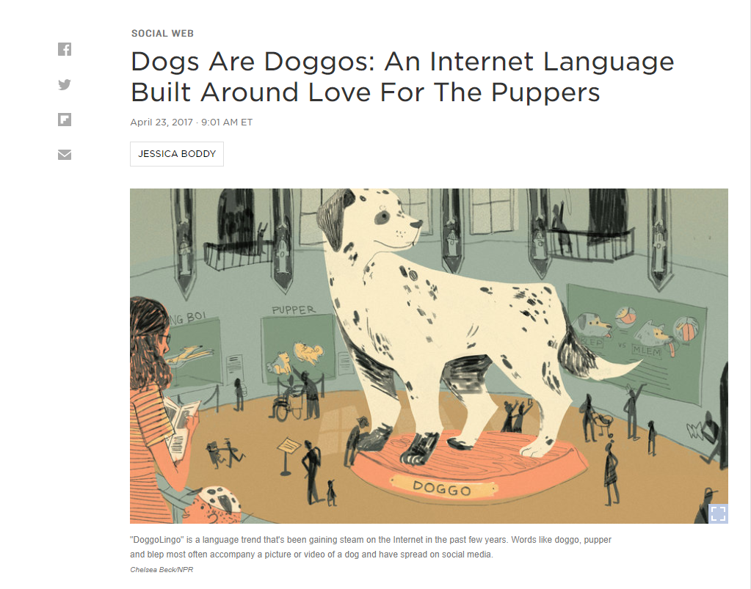
New Words Like “Doggos” And “Puppers”
https://www.npr.org/sections/alltechconsidered/2017/04/23/524514526/dogs-are-doggos-an-internet-language-built-around-love-for-the-puppers

Slide 11
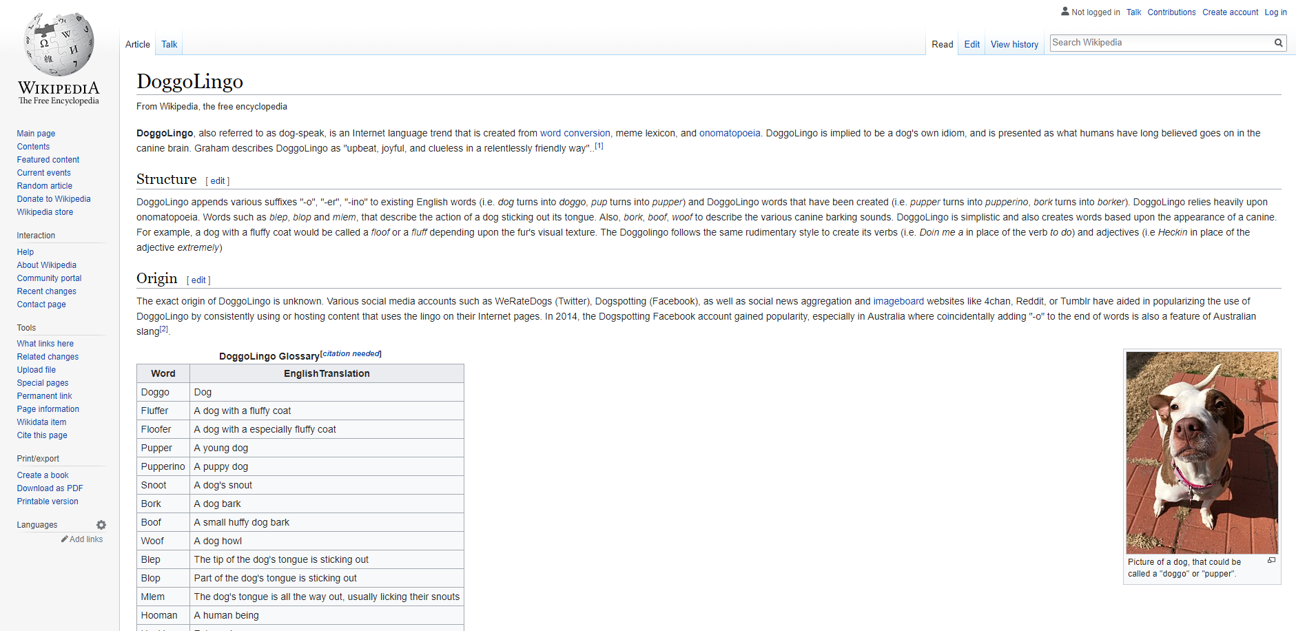
DoggoLingo
https://en.wikipedia.org/wiki/DoggoLingo

Slide 12
Internet Slang Creates New Languages
Are There Any Others?

Slide 13
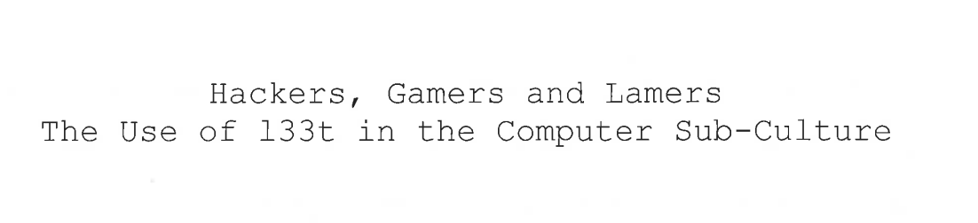
Thesis Written By B. Sherblom-Woodard On L33t
https://scholarship.tricolib.brynmawr.edu/bitstream/handle/10066/11233/Sherblom-Woodward_theis.pdf

Slide 14
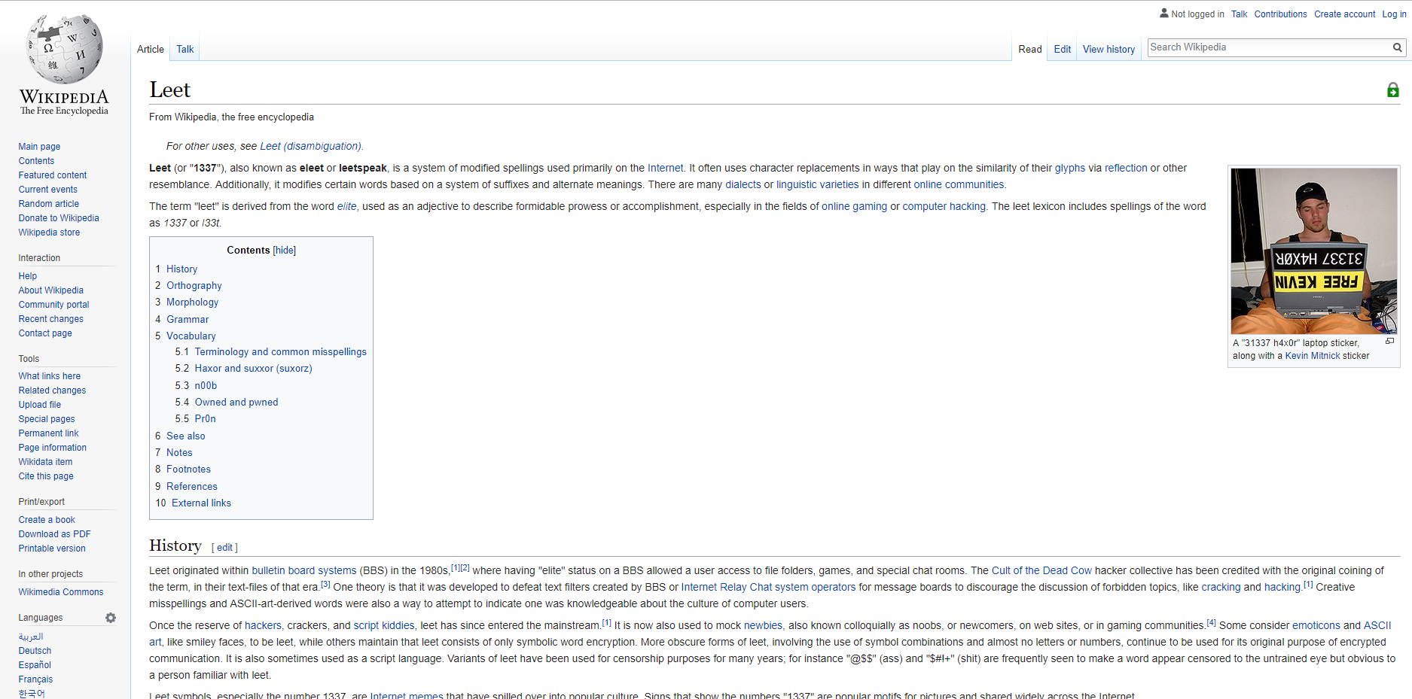
Leet Speak
https://en.wikipedia.org/wiki/Leet

Slide 15
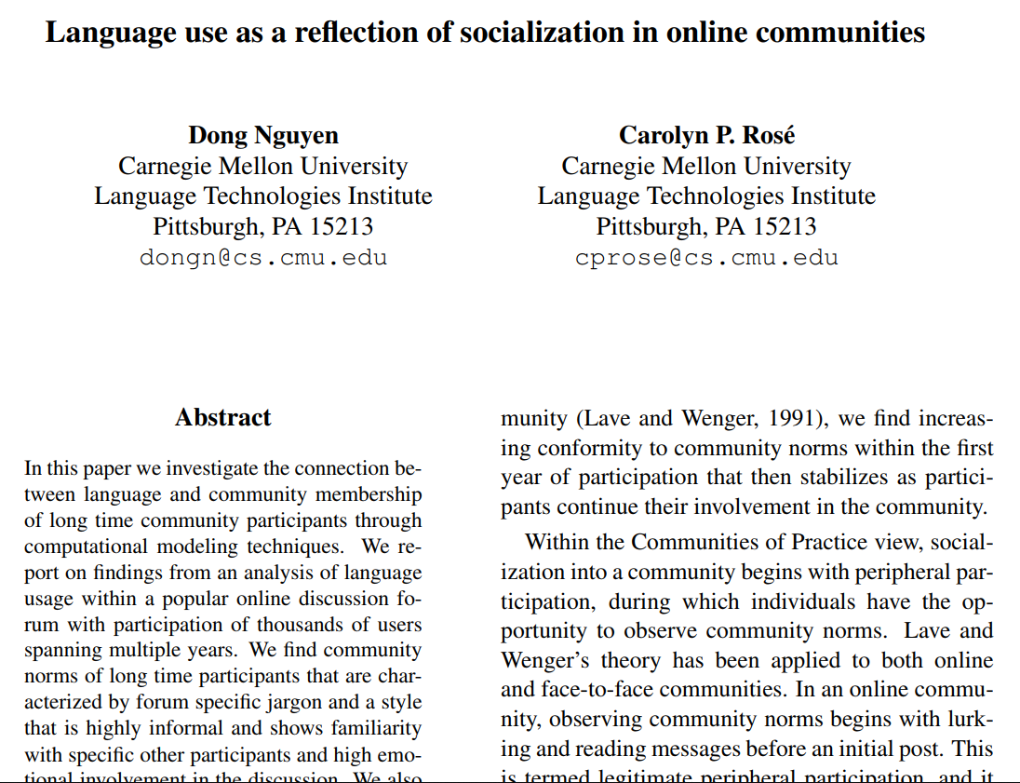
Social Effects Based On Use Of Language
http://delivery.acm.org/10.1145/2030000/2021119/p76-nguyen.pdf

Slide 16
Tracking Language Used By @dog_rates
Let’s Review The Popular Phrases Mentioned Before

Slide 17
The Phrase “H*ck”
Introduced 2016-08-08
Word referred originally as “heck” but this version is censored
Variations of this word are inclusive to any lexical permutation of the base word
https://scholar.google.com/scholar?oi=bibs&cluster=209679957075183025&btnI=1&hl=en

Slide 18
The Phrase “_/10. Would__”
Normally used on a 10/10 point scale.
Posts using this phrase consisted on a scale beyond the normal scale (ie. 14/10)
The “Would” portion of the phrase included something that would be done interacting with the particular dog within the picture attached to the post.
https://scholar.google.com/scholar?oi=bibs&cluster=209679957075183025&btnI=1&hl=en

Slide 19
The Analysis With Twitter
A Community Use Spectrum

Slide 20
Considered Variations
For “_/10. Would__”:
Find variations even with differing elements of punctuation, spacing, capitalization, portions of an alphanumeric string
For “h*ck”:
find exact match
https://scholar.google.com/scholar?oi=bibs&cluster=209679957075183025&btnI=1&hl=en

Slide 21
Defining Community Uses
“Out-community” considered a tweet created by an account that does not follow @dog_rates
“In-community” considered a tweet created by an account that follows @dog_rates
Excluded mentions of @dog_rates account to focus on community of followers
Types of “in-community” uses:
Mentioning a follower of @dog_rates
Mentioning a non-follower
Posting without any mentions
https://scholar.google.com/scholar?oi=bibs&cluster=209679957075183025&btnI=1&hl=en

Slide 22
The Analysis With Reddit
Linking the Community To An Outside Source

Slide 23
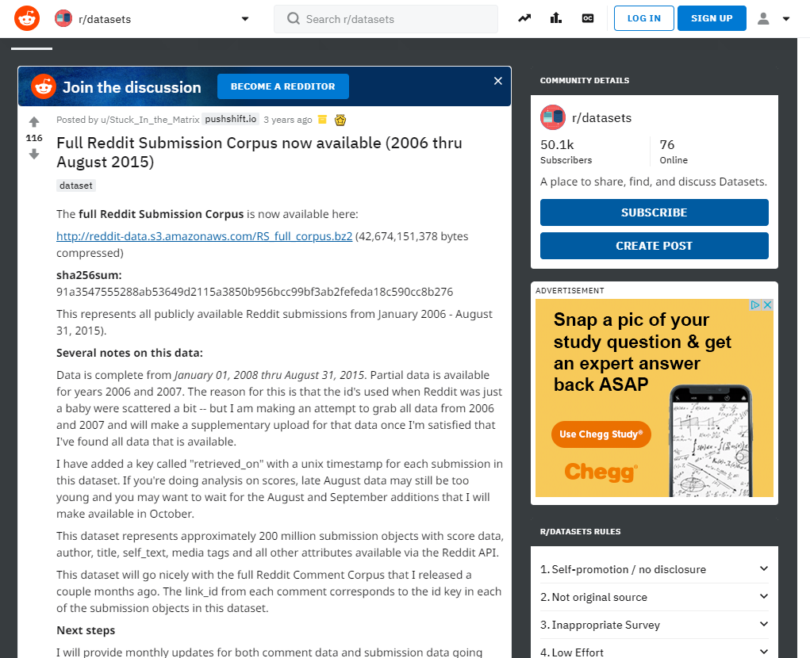
Reddit Dataset
https://www.reddit.com/r/datasets/comments/3mg812/fullredditsubmissioncorpusnowavailable2006/

Slide 24
Defining The Reddit Community
Titles containing @dog_rates
Ignore mentions or links to @dog_rates twitter account
https://scholar.google.com/scholar?oi=bibs&cluster=209679957075183025&btnI=1&hl=en

Slide 25
Results Of Analysis On Different Social Networking Platforms
Strong relationship between frequency and followers based on phrases used
Correlation between @dog_rates followers and use of “h*ck” is ⍴=0.87
Correlation between @dog_rates followers and use of “_/10. Would_” is ⍴=0.47
Usage of these phrases increase as the popularity of the @dog_rates account increases
After November 2015,
the phrase “_/10. Would__” shows significant increase
“h*ck” increases are less significant in comparison to its usage beforehand
https://scholar.google.com/scholar?oi=bibs&cluster=209679957075183025&btnI=1&hl=en

Slide 26
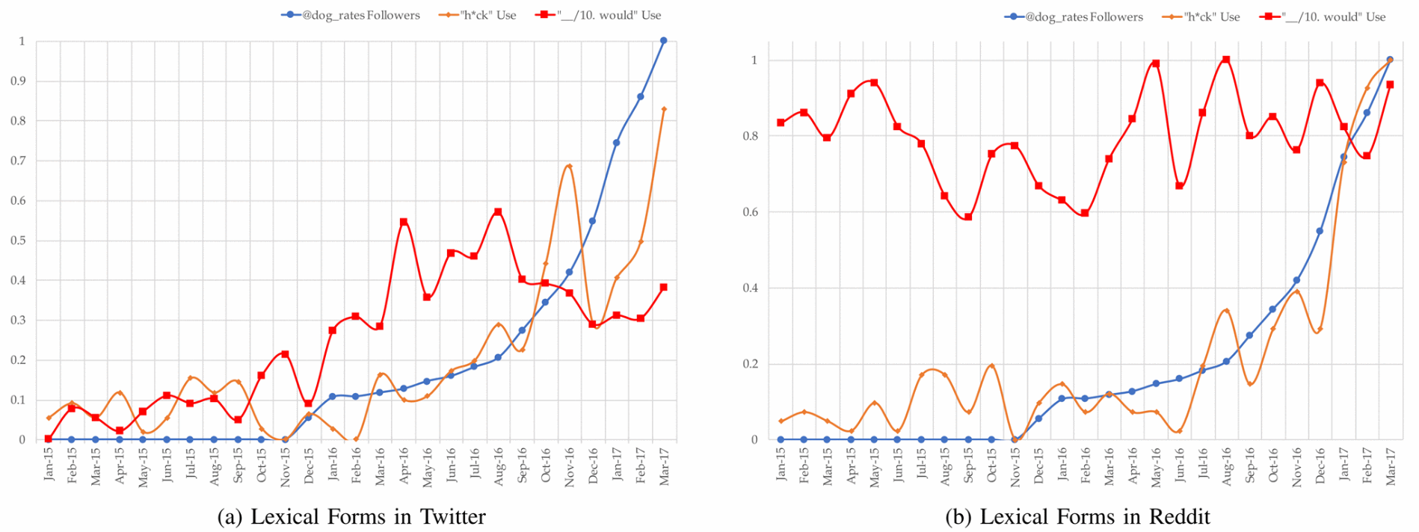
Frequency Of Phrases And Followers Taken From Both Reddit And Twitter
https://ieeexplore-ieee-org.proxy.lib.odu.edu/mediastore_new/IEEE/content/media/8488381/8508239/8508445/101_0587_124-fig-3-source-hires.gif

Slide 27
Concluding Remarks
Quick adoption of both phrases by both Twitter and Reddit
Study shows how an account can influence new language
Based on mentions, users are comfortable broadcasting new type of phrases outward into another community
Popularity of account influenced users to more frequently use phrases originating from the @dog_rates account
Results can be used to form a basis for a hypothesis towards understanding language based trends

Slide 28
Contact Information:
Github: https://github.com/mst3v3nsn
Google Groups: https://groups.google.com/forum/#!forum/cs895-s19

